Slide 1
Continuous Armed Bandit
Kohei Watanabe (Intern), Bin Yang (Mentor)
Intelligence domain
RIT Department

Slide 2


Self-Introduction
Kohei Watanabe
2nd year Master Student
Internship Period: 6/22 ~ 9/8 (3 or 4 days a week)
My Lab: Harada-Ushiku Lab (MIL) @Tokyo Univ.
Computer Vision, Machine-Learning…etc
WebDNN[1] is useful when you want to make a demo using deep learning!
[1] https://mil-tokyo.github.io/webdnn/ja/
Notes:
Web DNN

Slide 3
Motivation Continuous Armed Bandit: Hyperparameter Optimization
Designing next experiment based on the results of past experiments efficiently is valuable
especially when experiment cost is high
How many layers, neurons?
Caution
Categorical hyperparameter
is OUT of the target in this research.
e.g.
Activation function(relu, sigmoid, tanh, etc.)
Presence of Dropout

Slide 4
Motivation Hyperparameter Optimization of Recommendation engine
Also tuning the hyperparameter of recommendation engine
is valuable for improving CTR.

Slide 5
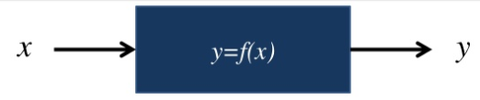
Problem Definition
Find the best parameter of Black Box function from observed and
Parameter
Performance
Input
Output (curve line)
: The point we need
Observations
Observations
Which curve line describes well?

Slide 6
Approaches
Random Search, Grid Search
Low computation cost, but inefficient
Sequential Model-based Algorithm Configuration (SMAC)
Sequential Model-Based Optimization (SMBO): Bayesian optimization
Tree-Structured Parzen Estimator (TPE)
Implemented in “Hyperopt”
[Base] Gaussian Process Upper Confidence Bounce (GP-UCB)
Many open source (python) libraries (“Gpyopt”, “RoBo”, …)
[Ours] Gaussian Markov Random Field UCB (GMRF-UCB)
Not so popular(?), No library

Slide 7
Approaches
Random Search, Grid Search
Low computation cost, but inefficient
Sequential Model-based Algorithm Configuration (SMAC)
Sequential Model-Based Optimization (SMBO): Bayesian optimization
Tree-Structured Parzen Estimator (TPE)
Implemented in “Hyperopt”
[Base] Gaussian Process Upper Confidence Bounce (GP-UCB)
Many open source (python) libraries (“Gpyopt”, “RoBo”, …)
[Ours] Gaussian Markov Random Field UCB (GMRF-UCB)
Not so popular(?), No library

Slide 8
What is Gaussian process (GP) , Gaussian Markov Random Field (GMRF)?
Both GP and GMRF can estimate the
Performance of unseen parameters
Uncertainty of unseen parameters or
High performance or high uncertain parameters are easy to be sampled!
GP
GMRF
GP estimate the covariance
using Kernel
GMRF estimate the precision matrix (inverse of covariance matrix)
using the relation between nodes

Slide 9
How does GP-UCB work?

Slide 10
How does GP-UCB work?

Slide 11
How does GP-UCB work?

Slide 12
How does GP-UCB work?

Slide 13
How does GP-UCB work?

Slide 14
How does GP-UCB work?

Slide 15
How does GP-UCB work?

Slide 16
How does GP-UCB work?

Slide 17
How does GP-UCB work?

Slide 18
How does GP-UCB work?

Slide 19
How does GP-UCB work?

Slide 20
How does GP-UCB work?

Slide 21
How does GP-UCB work?
Converged!

Slide 22
Experiment

Slide 23
GMRF-UCB: Before Experiment…
How should hyperparamters of GMRF should be set?
GP Libraries often sample some points (known as “burnin”) and estimate its hyperparamters by optimizing the log-marginal-likelihood (or MCMC)
But this didn’t work well in GMRF☹
In our many experiments, we found that these worked well
Normalizing output (mean0var1 or min0max1)
Pairwise-sampling, then estimate and the other hyperparameters
Pairwise grid-based burn-in

Slide 24
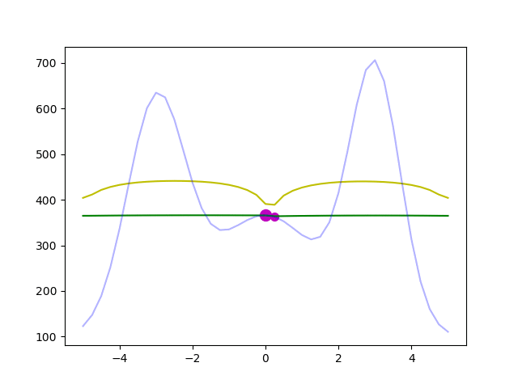
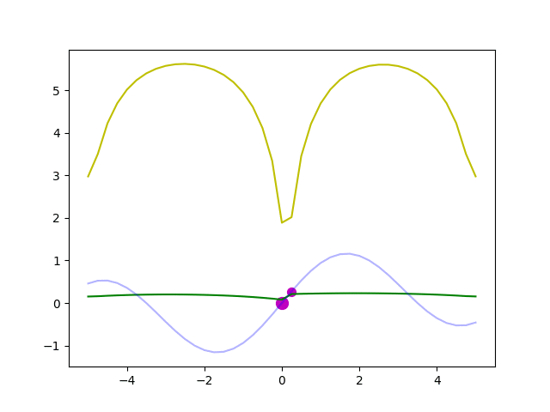
GMRF-UCB: Before Experiment…
How should hyperparamters of GMRF should be set?
GP Libraries often sample some points (known as “burnin”) and estimate its hyperparamters by optimizing the log-marginal-likelihood (or MCMC)
But this didn’t work well in GMRF☹
In our many experiments, we found that these worked well
Normalizing output (mean0var1 or min0max1)
Pairwise-sampling, then estimate and the other hyperparameters
Pairwise grid-based burn-in
Ground Truth
Predicted Mean
Predicted UCB

Slide 25
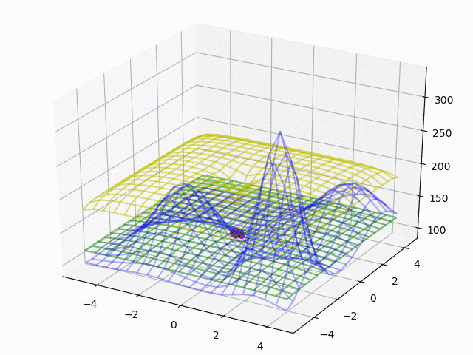
GMRF-UCB: Before Experiment…
How should hyperparamters of GMRF should be set?
GP Libraries often sample some points (known as “burnin”) and estimate its hyperparamters by optimizing the log-marginal-likelihood (or MCMC)
But this didn’t work well in GMRF☹
In our many experiments, we found that these worked well
Normalizing output (mean0var1 or min0max1)
Pairwise-sampling, then estimate and the other hyperparameters
Pairwise grid-based burn-in
Ground Truth
Predicted Mean
Predicted UCB

Slide 26
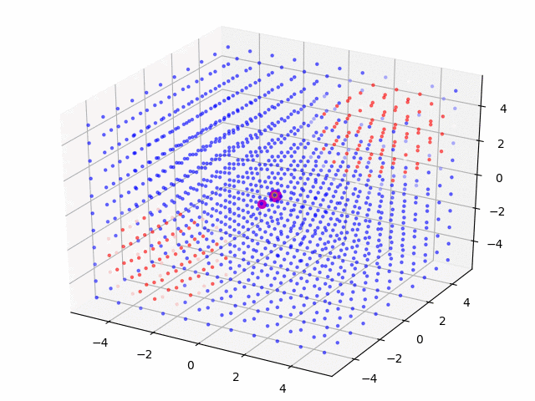
GMRF-UCB: Before Experiment…
How should hyperparamters of GMRF should be set?
GP Libraries often sample some points (known as “burnin”) and estimate its hyperparamters by optimizing the log-marginal-likelihood (or MCMC)
But this didn’t work well in GMRF☹
In our many experiments, we found that these worked well
Normalizing output (mean0var1 or min0max1)
Pairwise-sampling, then estimate and the other hyperparameters
Pairwise grid-based burn-in
High
Low

Slide 27
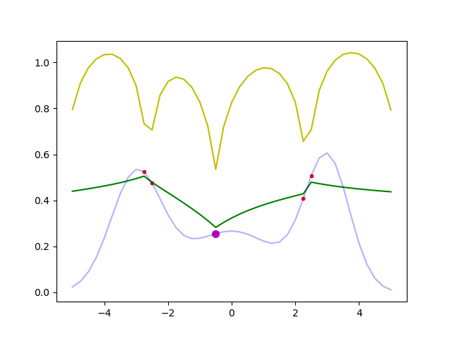
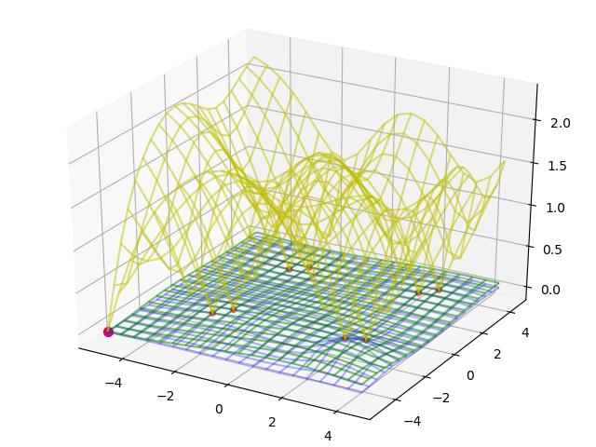
GMRF-UCB: Before Experiment…
How should hyperparamters of GMRF should be set?
GP Libraries often sample some points (known as “burnin”) and estimate its hyperparamters by optimizing the log-marginal-likelihood (or MCMC)
But this didn’t work well in GMRF☹
In our many experiments, we found that these worked well
Normalizing output (mean0var1 or min0max1)
Pairwise-sampling, then estimate and the other hyperparameters
Pairwise grid-based burn-in
Sampling only center 2*d points as burn-in
Ground Truth
Predicted Mean
Predicted UCB
Notes:
Continuing pairwise sampling is not so good because one point has a little poorer performance than the other.
We find it efficient to start just pairwise sampling center 2d points as burnin then quit pairwise sampling and sample just one point.

Slide 28
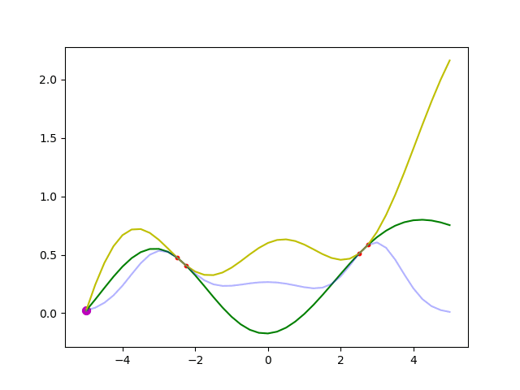
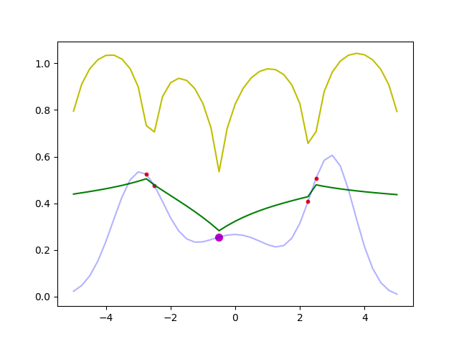
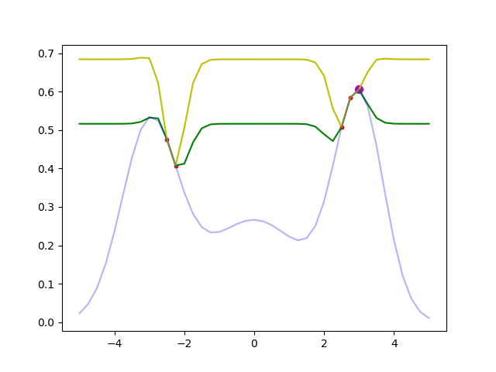
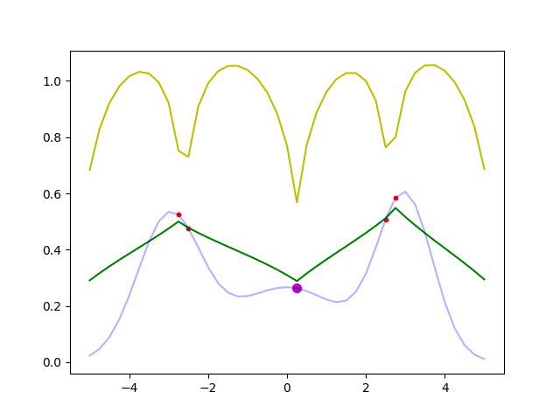
Result: Comparison between GP-UCB and GMRF-UCB
The performance of GP is affected by its Kernel hyperparameter
GP
GMRF
Fixed Kernel
Mean0-Var1 Normalization
Ground Truth
Predicted Mean
Predicted UCB
Unfixed Kernel
Min0-Max1 Normalization

Slide 29
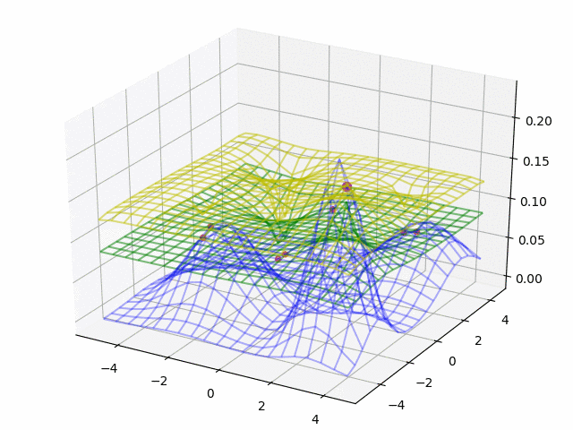
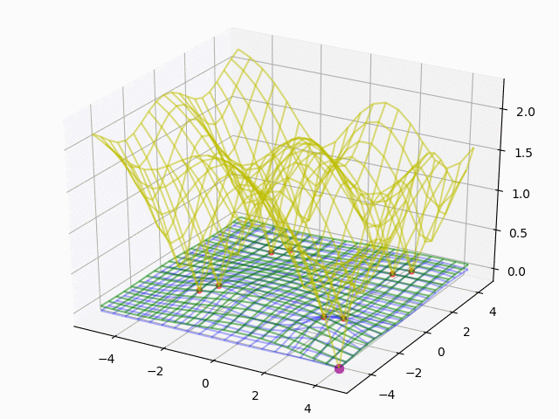
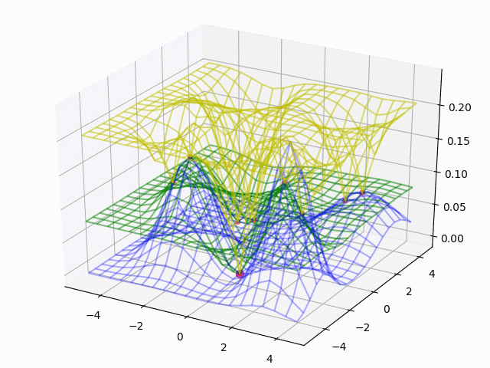
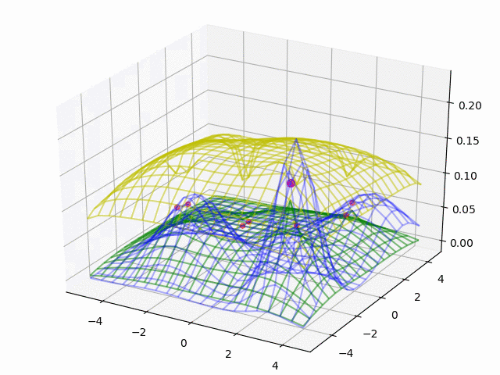
Result: Comparison between GP-UCB and GMRF-UCB
The performance of GP is affected by its Kernel hyperparameter
GP
GMRF
Fixed Kernel
Mean0-Var1 Normalization
Ground Truth
Predicted Mean
Predicted UCB
Unfixed Kernel
Min0-Max1 Normalization

Slide 30
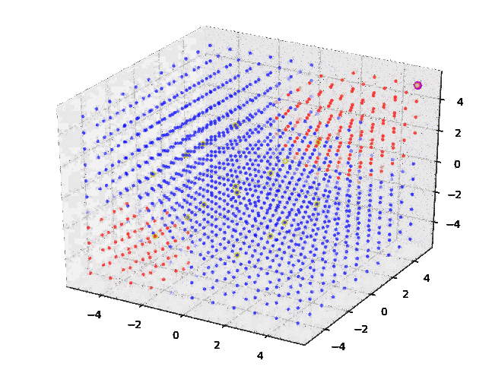
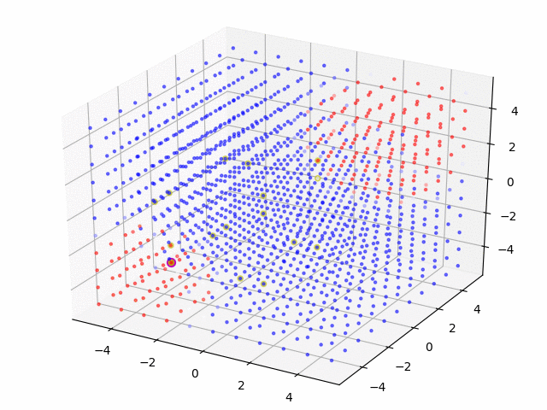
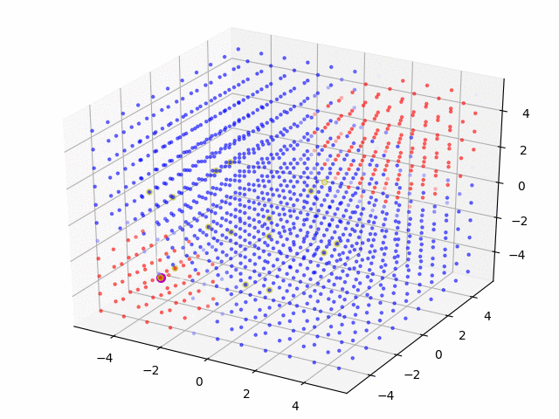


Result: Comparison between GP-UCB and GMRF-UCB
The performance of GP is affected by its Kernel hyperparameter
GP
GMRF
Fixed Kernel
Mean0-Var1 Normalization
High
Low
Unfixed Kernel
Min0-Max1 Normalization

Slide 31
Pros and Cons between GP and GMRF
 | GP | GMRF
Continuous Space | ○ | ×
Memory Efficiency (The number of parameters) | Linearly Increasing | Constant
Difficulty of hyperparameter tuning | ○or△(maximizing loglikelihood is not so hard but a little unstable) | △ (pairwise sampling is not so good)
Extensibility | △ (Most implementation considers the number of samples per point is just a few) | ○ (My implementation considers the number of samples per point can be many)
https://github.com/scikit-learn/scikit-learn/issues/3162

Slide 32
Acquisition Functions except UCB
Actually UCB is just one solution. The others are
Thompson Sampling (TS) :
Just sampling. Performance is good, but computation is heavy…
Probability Improvement (PI):
PI is said to be too greedy.
Expected Improvement (EI):
EI seems to be the most popular. (In most libraries, default setting is EI)

Slide 33
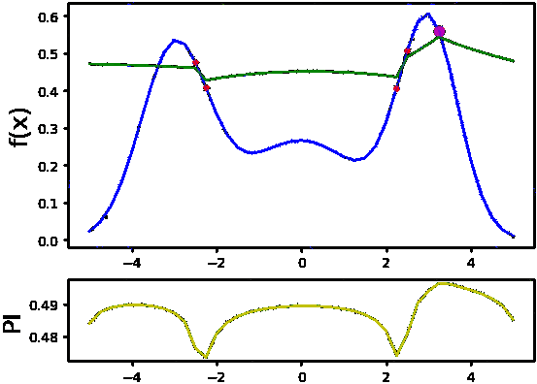
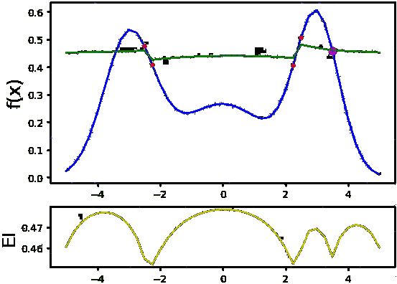
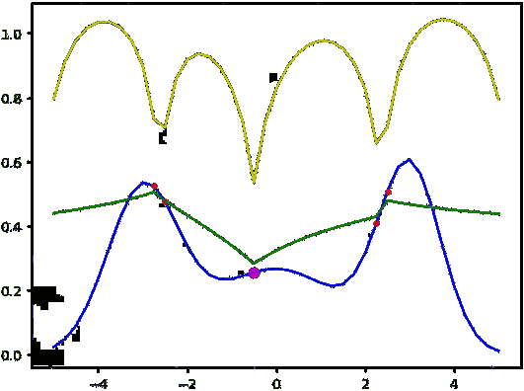
Result: Comparison of different acquisition functions (GMRF)
UCB
PI
EI
Ground Truth
Predicted Mean
Predicted Acq.

Slide 34
Idea of GMRF Application to improve CTR

Slide 35
How to apply GMRF for improving CTR
So far, we sampled just one(or a few) time(s) per point.
When we tune the hyper-parameter of some ML (e.g. Recommendation) engine for improving CTR, the number of samples per point are quite many.
In order to apply GMRF,
CTR data can be converted to real value using logit function.
 | Visit | Click
Point20 | 1000 | 123
Point21 | 1000 | 99
Point09 | 1000 | 876
... | ... | ...
 | Visit | Val
Point20 | 1000 | -1.964
Point21 | 1000 | -2.208
Point09 | 1000 | 6.906
... | ... | ...

Slide 36
Flow of GMRF application for improving CTR
 | Visit | Click
Point20 | 1000 | 123
Point21 | 1000 | 99
Point09 | 1000 | 876
... | ... | ...
 | μ | σ
Point01 | 0.021 | 3.5e-5
Point02 | 0.014 | 5.1e-5
Point03 | -0.013 | 8.7e-6
... | ... | ...
GMRF
CTR Experiment
 | Visit | Click
Point01 | 1500 | ?
Point02 | 3000 | ?
Point03 | 4000 | ?
... | ... | ...
Total Impressions
Generate probability
per point
MB Bandit

Slide 37
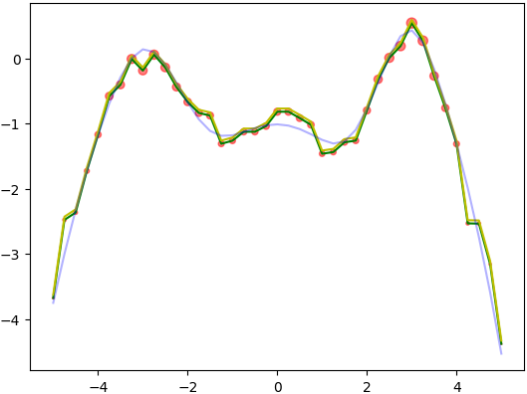
Result of GMRF application for improving CTR
The number of impressions
per one iteration
is set 10000
Ground Truth
Predicted Mean
Predicted UCB
At first,
10000 impressions are distributed equally to each point
Then GMRF was applied.
After 1st iteration
Size of shows the distribution of clicks

Slide 38
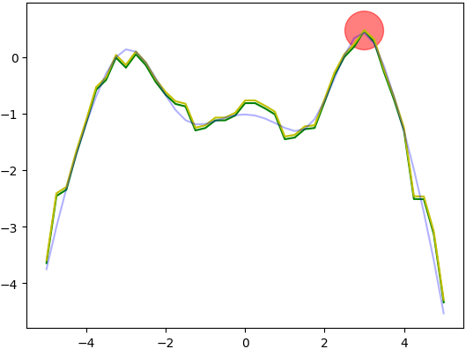
Result of GMRF application for improving CTR
The number of impressions
per one iteration
is set 10000
Ground Truth
Predicted Mean
Predicted UCB
At first,
10000 impressions are distributed equally to each point
Then GMRF was applied.
After 1st iteration
Size of shows the distribution of clicks
Found the best point and
Converged!
After 2nd iteration

Slide 39
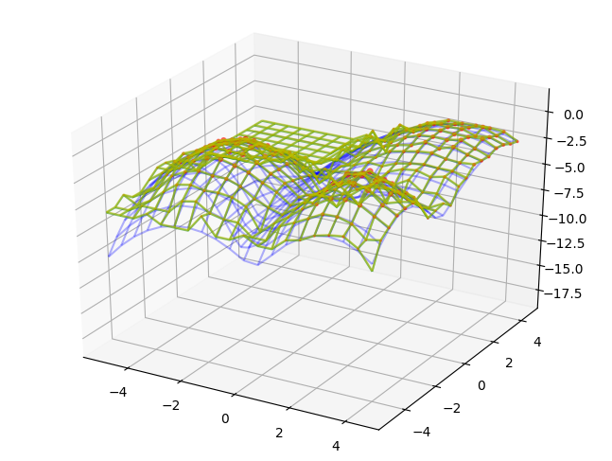
Result of GMRF application for improving CTR
The number of impressions
per one iteration
is set 10000
After 1st iteration
Ground Truth
Predicted Mean
Predicted UCB
At first,
10000 impressions are distributed equally to each point
Then GMRF was applied.
Size of shows the distribution of clicks

Slide 40
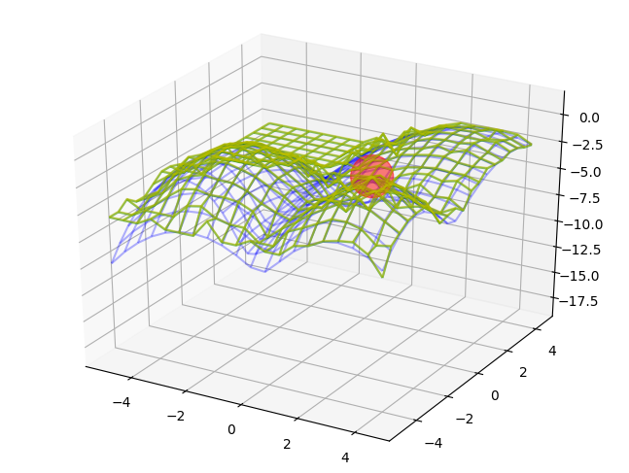
Result of GMRF application for improving CTR
The number of impressions
per one iteration
is set 10000
After 1st iteration
Ground Truth
Predicted Mean
Predicted UCB
At first,
10000 impressions are distributed equally to each point
Then GMRF was applied.
Size of shows the distribution of clicks
After 2nd iteration
Found the best point and
Converged!

Slide 41
Summary and Future Work
Summary
Propose to use GP and GMRF for hyperparamter optimization
Propose the way to apply GMRF for improving CTR
Future work
Find or fix(?) the way to optimize hyperparamter of GMRF (Pairwise sampling should be avoided)
Write a paper with new intern Mr. Zhao and my mentor Dr. Yang
Extend our model to dynamic version

Slide 42
Appendix

Slide 43
References
ベイズ的最適化(Bayesian Optimization)の入門とその応用
https://www.slideshare.net/issei_sato/bayesian-optimization

Slide 44
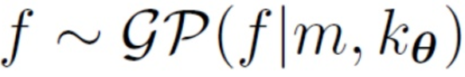
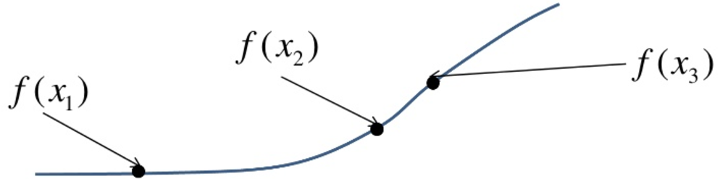
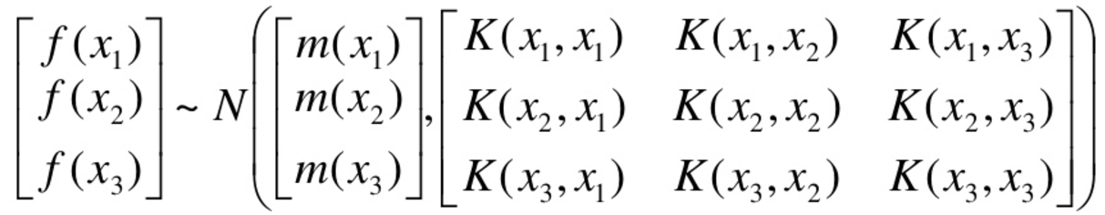
GP-UCB: What is GP?
Gaussian Process
Every point in some continuous input space is associated with a normally distributed random variable
“Kernel”
Distance between two points
e.g.) Gaussian Kernel
“Mean”

Slide 45
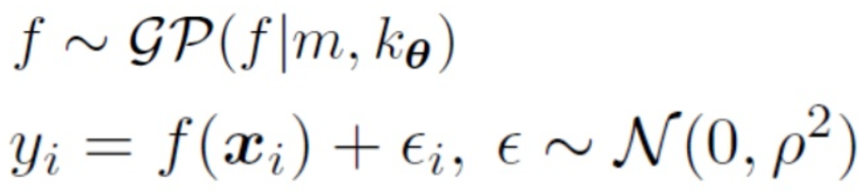
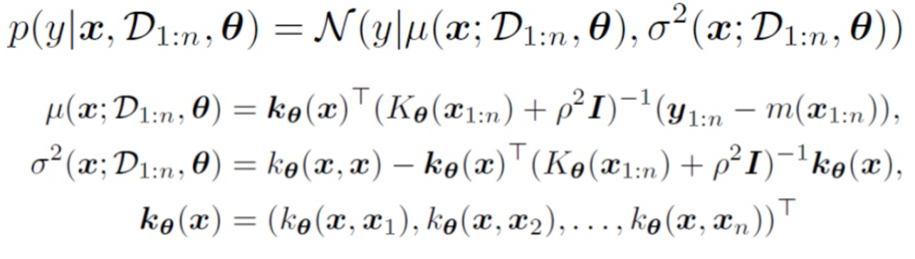
GP-UCB: How does GP predict?
Generation Process
Bayesian Predicted Distribution

Slide 46
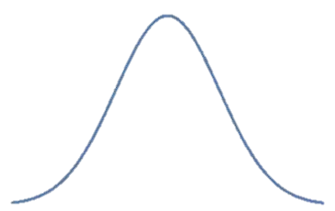
GP-UCB: What is UCB (Upper Confidence Bound) ?
Next Sampling point
Notes:
Add more info

Slide 47
GMRF-UCB: Introduction
Split the continuous space to discrete one
Considering that the adjacent point has relation with each other, Simply model this, introducing hidden nodes!
The joint probability can be calculated as follows;
: the connection strength between and
: the connection strength between and
Hidden node
Observed node

Slide 48
GMRF-UCB: How to model
Let’s make this model more sophisticated
The joint probability can be calculated as follows;
: the connection strength between and
: the connection strength between and
Hidden node
Observed node
Two Points of Modification
should have prior Gaussian distribution
The number of would be plural ( should be replaced to )
①
②
Removed
Index
to simplify
Real
Simple

Slide 49
GMRF-UCB: How to model
Let’s make this model more sophisticated
The joint probability can be calculated as follows;
: the connection strength between and
: the connection strength between and
Hidden node
Observed node
Combining these….
①
②
Removed
Index
to simplify
Real
Simple

Slide 50
GMRF-UCB: How to model
Final GMRF can be calculated as follows;

Slide 51
GMRF-UCB: How to model
Final GMRF can be calculated as follows;

Slide 52
GMRF-UCB: How to model
Final GMRF can be calculated as follows;
Why A’ is used instead of A?

Slide 53
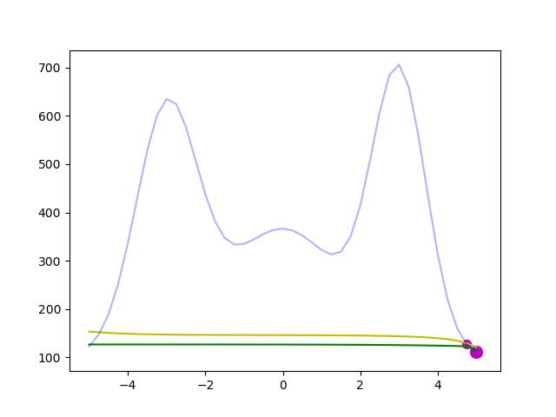
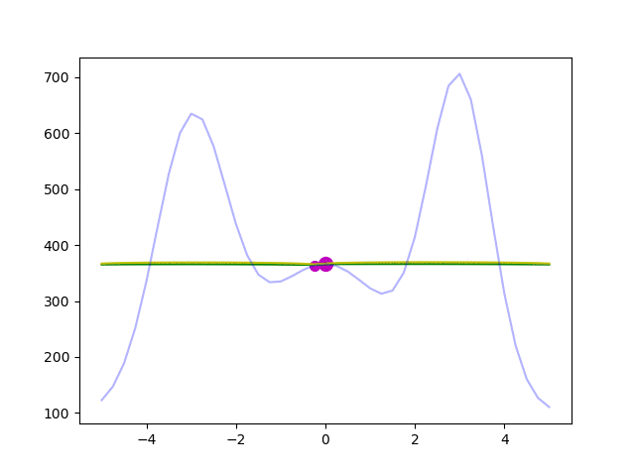
GMRF-UCB: How to model
Comparison between A and A’
Ground Truth
Predicted Mean
Predicted UCB
If A is used, edge points are easier to be selected than center points

Slide 54
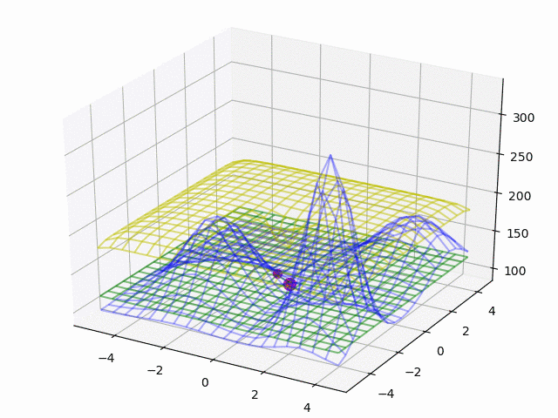
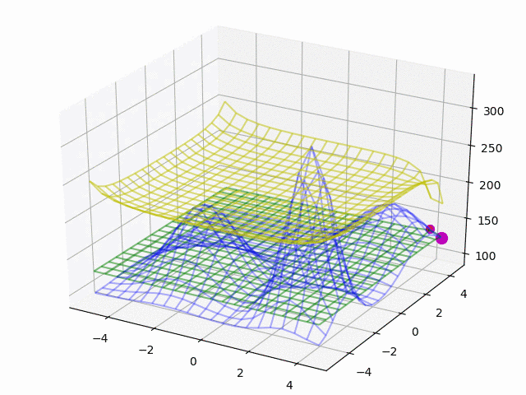
GMRF-UCB: How to model
Comparison between A and A’
Ground Truth
Predicted Mean
Predicted UCB
If A is used, edge points are easier to be selected than center points

Slide 55
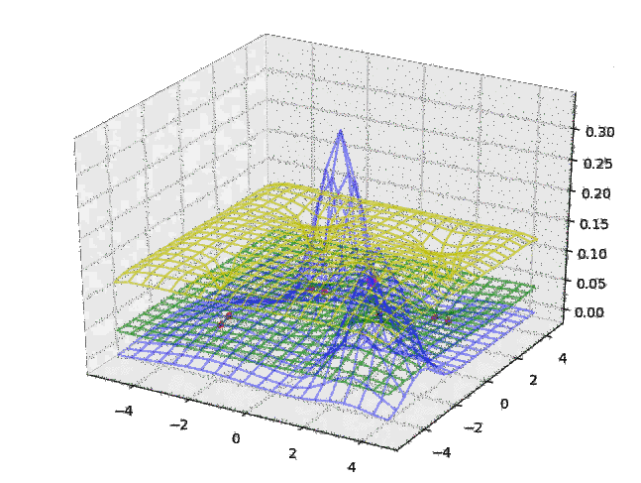
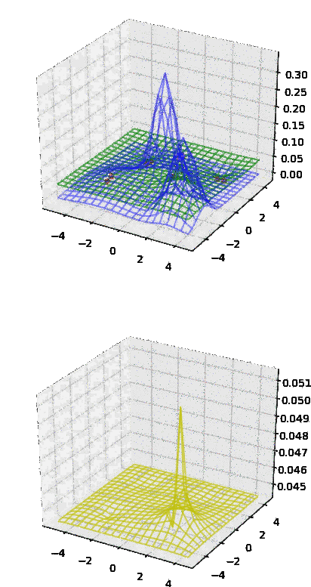
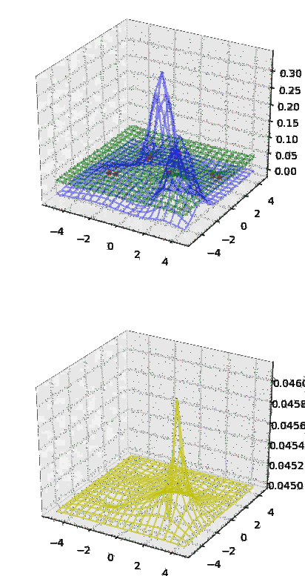
Poor Result: Comparison of different acquisition functions (GMRF)
UCB
PI
EI
Ground Truth
Predicted Mean
Predicted Acq.

